Slide 1
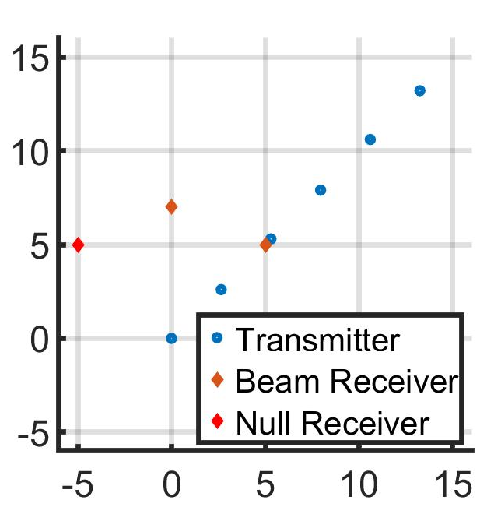
(x,y)-Position of Agents and Receivers
feasibility check –
both the free-space and actual systems are full-rank

Slide 2
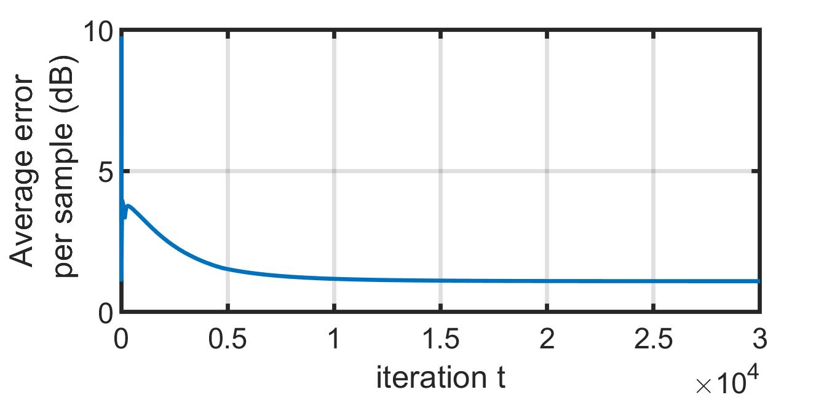
Error Plot of IPG
only |E_z| is considered

Slide 3
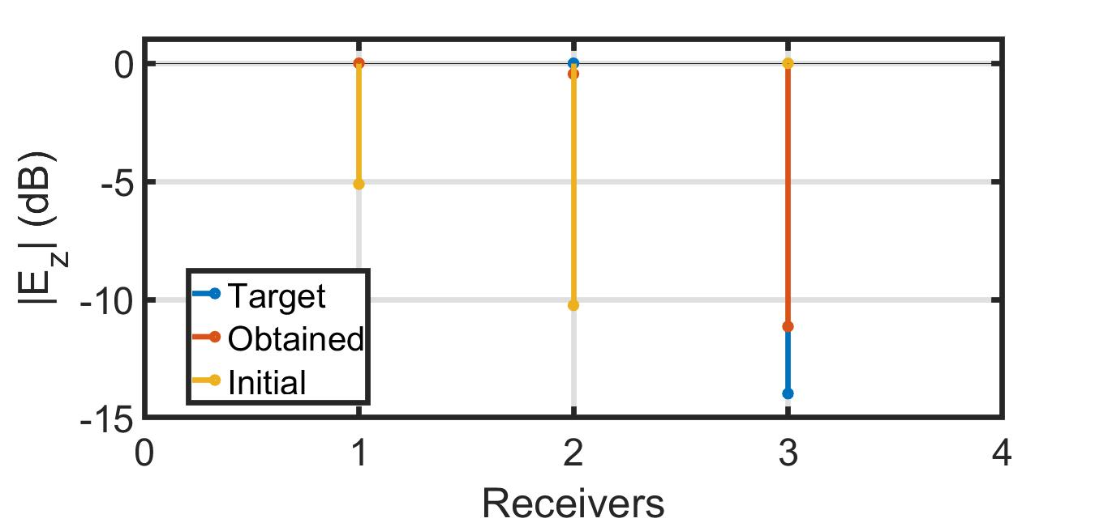
Amplitude Pattern of Electric Field in z-Direction

